Slide 1

E-R DIAGRAM
Name: SUKSHITH
Roll No: 24075a7201

Slide 2
Entity-Relationship (ER) diagram is a visual representation of entities (such as tables in a database), their attributes, and the relationships between them. It helps in designing the database structure and identifying how different data points interact with each other.

Slide 3
KEY TERMS IN ER MODEL
Entity:
Attribute
Entity Set
Relationship

Slide 4
TYPES OF ENTITY
STRONG ENTITY
WEAK ENTITY
Represntation of entity
Strong Entity Weak Entity

Slide 5
SYMBOLS FOR ATTRIBUES , RELATIONSHIP
Relationship
Attribute
Multivalued
Atrribute
weak Relationship
Key Attribute

Slide 6
Types of Attributes
Simple Attribute
Composite Attribute
Derived Attribute
Single Attribute
Multi –Valued Attribute
Key Attriibute

Slide 7
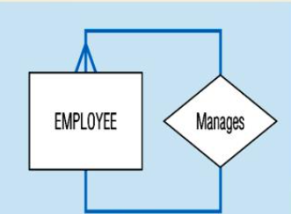
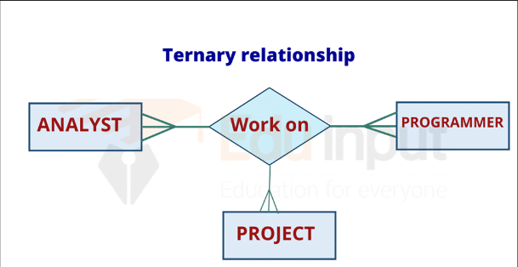

DEGREE OF RELATIONSHIP
Unary Relationship Binnary Relationship Ternnary Relationship

Slide 8
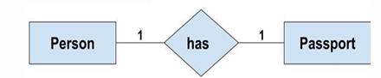
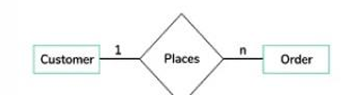
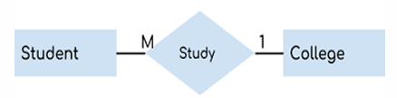
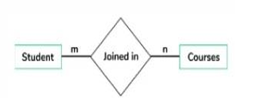
TYPES OF RELATIONSHIP
ONE - TO – ONE Relationship ONE – TO –MANY Relationship
Many- to-One Relationship Many-to-Many Relationship

Slide 9
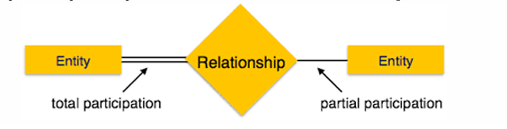
PARTICPATING CONSTRAINTS
Total Particpation
Parial Particpating
Example:

